Slide 1
2G, 3G, 4G, 5G NETWORK
TARIKUZZAMAN EMON
ASSISTANT PROFESSOR
STAMFORD UNIVERSITY BANGLADESH

Slide 2


Empowered by Mobile Networks
Internet
… ...
Mobile
Client
Network
Infrastructure
the only large-scale, wide-area wireless network system in par with the Internet
Notes:
To connect these smartphones and the Internet, the key enabler is the underlying mobile networked system.
Mobile clients first get wireless access to the base stations and then traverse several gateways in the rest mobile network infrastructure and finally reach the external Internet.
(3) So far and also in the coming years, this is still the only large-scale, wide-area wireless network system, which complements the wired Internet.

Slide 3
Empowered by Mobile Networks
… ...
Wireless
(radio access technology)
Network
Infrastructure
Mobile
Client
Notes:
To connect these smartphones and the Internet, the key enabler is the underlying mobile networked system.
Mobile clients first get wireless access to the base stations and then traverse several gateways in the rest mobile network infrastructure and finally reach the external Internet.
(3) So far and also in the coming years, this is still the only large-scale, wide-area wireless network system, which complements the wired Internet.

Slide 4








Mobile Network Evolution
1G
AMPS, NMT
TACS
2G
GSM/GPRS/ EDGE
cdmaOne
3G
WCDMA/HSPA+
CDMA2000/EVDO
TD-SCDMA
4G
LTE
LTE-A
1G 2G 3G 4G 5G
Mid 1980s 1990s 2000s 2010s 2020s
analog
voice
Digital voice
+ Simple data
Mobile
broadband
Mobile Internet
More & faster
Notes:
All these are empowered by the evoluation of mobile networks.
Today, the world is advancing to 4G LTE and even LTE advanced.
At this time point, almost everyone knows that 3G/4G mobile networks are everywhere.
This fact can be easily supported by many numbers.
For example, 3G/4G have been deployed in 203 countries; serving 6.8 billions user.
By 2014 (this year), it will go beyond our global population.
Last year, more than half a billion smartphones and tablets are shipped,
The market is $1 trillion by 2016.
And so on…
=========================================================
Mobile network is the largest scale wireless infrastructure.
It covers the whole planet and serves billions of users.
It provides mobile users with data service and carrier-grade quality voice service

Slide 5
1G

Slide 6
1G (First Generation) is the name given to the first generation of mobile telephone networks.
Circuit-switched technology.
FDMA (Frequency Division Multiple Access).
Analog system.
Basic mobility.
Poor voice quality.
Poor security.

Slide 7
2G

Slide 8
• Digital –consists of 1s and 0s
•Digital signal:
Low level,
High level,
Rising edge,
Falling edge
2
1
1
3
0
0
0
1
4

Slide 9
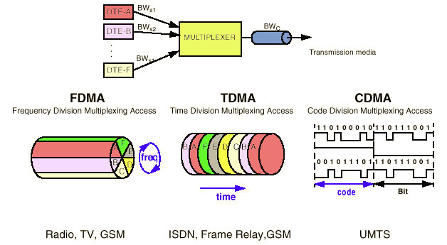
2G
Digital data can be compressed and multiplexed much more effectively than analog voice encodings.
•Multiplexing -multiple analog message signals or digital data streams are combined into one signal.

Slide 10
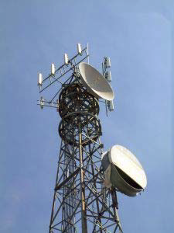

Allows for lower powered radio signals that require less battery power.
Digital voice data can be compressed and multiplexed much more effectively than analog.
CODEC introduction -program that encodes and decodes digital data stream or signal.
•Translates data from digital to analog and vice .
Speaker
CODEC
0101110
Voice

Slide 11

2G
•Advantages:
The digital voice encoding allows digital error checking
•increase sound quality
•lowers the noise level
Going all-digital allowed for the introduction of digital data transfer.
•SMS –“short message service”
•E-mail

Slide 12
2G
Disadvantages
Cell towers had a limited coverage area.
Built mainly for voice services and slow data.

Slide 13
2.5G
2G Enhanced

Slide 14
Lies somewhere between 2G and 3G.
The development of 2.5G has been viewed as a stepping-stone towards 3G.
Was prompted by the demand for better data services and access to the internet.
Provides faster services than 2G, but not as faster as advanced as the newer 3G systems.

Slide 15
Extends the capabilities of 2G systems by providing additional features, such as a packet-switched connection(GPRS) in the TDMA-based GSM system, and enhanced data rates (HSCSD and EDGE).
GPRS: General Packet Radio Services.
EDGE: Enhanced Data for Global Evolution.
HSCSD: High Speed circuit-switched data.

Slide 16
3G

Slide 17
3G
Large capacity and broadband capabilities. •Allows the transmission of 384kbps for mobile systems and up to 2Mbps.
•Increased spectrum efficiency –5Mhz–
-A greater number of users that can be simultaneously supported by a radio frequency bandwidth.
• High data rates at lower incremental cost than 2G.
• Global roaming

Slide 18
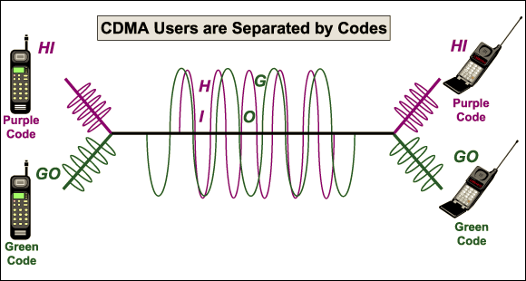
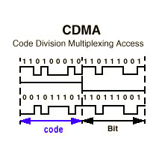
3G
CDMA –Code Division Multiple Access.
Does not divide up the channel by time or frequency.
Encodes data with a special code associated with each channel.

Slide 19
Data Rates Comparison (Kbps)

Slide 20

Evolution To 4G
Ever wonder where your life is going.

Slide 21
Evolution to 4G
CDMA
GSM/UMTS
IEEE Cellular
IEEE LAN
2G
CDMA IS-95A
GSM
TDMA IS-136
IEEE 802.16
IEEE 802.11
2.5G
CDMA IS-95B
GPRS
IEEE 802.11a
3G
CDMA 2000
E-GPRS EDGE
WCDMA FDD/TDD
TD SCDMA LCR-TDD
IEEE 802.11g
3.5G
1x Ev-DO
Rev O/A/B
HSDPA
FDD/TDD
HSUPA
FDD/TDD
Fixed WiMAX 802.16d
Wi BRO
IEEE 802.11g
3.9G
UMB 802.20
LTE
E-UTRA
HSPA+
Mobile WiMAX 802.16e
IEEE 802.11n

Slide 22
Technology moving towards 4G
Mobility
1995
2000
2005
2010+
4G
High speed
3G LTE
3G
(IMT2000)
Medium speed
Mobile WiMAX
(WiBRO)
CDMA/GSM/TDMA
2G
(Digital)
CDMA/GSM/TDMA
High Speed WLAN
1G
(Analog)
WPAN
5 GHz WLAN
Low speed
2.4 GHz WLAN
Bluetooth
Data Rates
~14.4 kbps
144 kbps
384 kbps
<50 Mbps
<100 Mbps

Slide 23
Mobility
High speed
Medium speed
4th Generation
(2007-2010)
3th Generation
(IMT-2000)
(2001)
2G
2G
2.5G
Walking/ Local area
Standing/
Indoor
Data Rates
0.1
1
10
100

Slide 24
4G Communication System

Slide 25
Seamless Roaming
"Seamless" and "wireless," when put together, represent a technology of wireless Internet that hands you off to another network without interruption so you may continue your activities online without even noticing that you connected into another network. Another name for it is "seamless roaming."

Slide 26
Seamless Connection of Networks in 4G
Cellular 2.5G (GSM etc.
Cellular 3G (UMTS etc.
Digital Audio/Video Broadcast
Connection Layer
Core IP Network
Cellular 4G
Short Range PAN/LAN/
MAN/WAN
WLAN/
HIPER-LAN

Slide 27
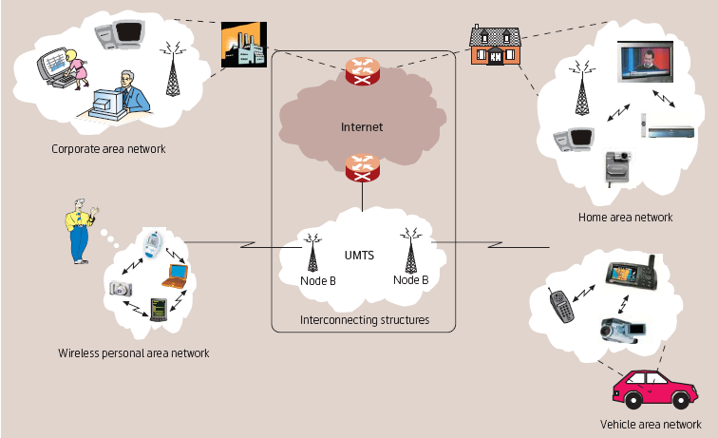

Slide 28
Features of 4G:
•Faster and more reliable.
100 Mb/s (802.11g wireless = 54Mb/s, 3G = 2Mb/s)
•Lower cost than previous generations
•Multi-standard wireless system.
–Bluetooth, Wired, Wireless (802.11x)
•Ad Hoc Networking.
•IPv6 Core.
•OFDM used instead of CDMA.
•Potentially IEEE standard 802.11n
–Most information is proprietary.

Slide 29
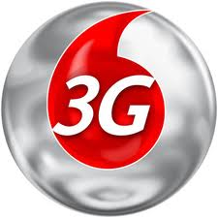
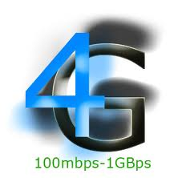
vs.
Technology | 3G | 4G
Frequency Band | 1.8 - 2.5GHz | 2 - 8GHz
Bandwidth | 5-20MHz | 5-20MHz
Data Rates | Up to 2Mbps | 100Mbps moving - 1Gbps stationary
Access | W-CDMA | VSF-OFCDM and VSF-CDMA
FEC | Turbo-codes | Concatenated codes
Switching | Circuit/Packet | Packet

Slide 30
Standards Body: 3GPP
An international standards body
Evolves and standardizes GSM, UMTS, LTE among others
The 3rd Generation Partnership Project (3GPP) unites [Six] telecommunications standard development organizations (ARIB, ATIS, CCSA, ETSI, TTA, TTC), known as “Organizational Partners” and provides their members with a stable environment to produce the highly successful Reports and Specifications that define 3GPP technologies
We will primarily discuss 3GPP standards
Notes:
There are other standards, like 3GPP2, 5GPP

Slide 31
Cellular Network Standards
3GPP2
3GPP
Circuit Switched
3GPP
Packet Switched
Wimax Forum
Generation
2G
GSM
cdmaOne
GPRS
2.5G
2.75G
EDGE
3G
UMTS
CDMA2000
3.5G
HSPA/+
CDMA EV-DO
4G
LTE
UMB
WiMAX
31

Slide 32
What is LTE?
LTE stands for “Long Term Evolution”
Fourth-generation (4G) cellular technology from 3GPP
Deployed worldwide
4G LTE: First global standard
Increased speed
IP-based network (All circuits are gone/fried!)
New air interface: OFDMA (Orthogonal Frequency-Division Multiple Access), MIMO (multiple antennas)
Also includes duplexing, timing, carrier spacing, coding...
New service paradigm (e.g., VoLTE)
Notes:
CAT 3, CAT 4, CAT 6 (different radio technology), → different speed
All implementations must meet baseline requirements
Increased speed
IP-based network (All circuits are gone/fried!)
New air interface: OFDMA (Orthogonal Frequency-Division Multiple Access), MIMO (multiple antennas)
Also includes duplexing, timing, carrier spacing, coding...

Slide 33
What is LTE?
LTE is always evolving and 3GPP often has new “releases”
First release: Rel-8
Current: Rel-11, Rel-12
Toward LTE-Advanced (4.5G)
Notes:
CAT 3, CAT 4, CAT 6 (different radio technology), → different speed
Enhancement over time (CAT3, CAT 4, CAT 6),
All implementations must meet baseline requirements
Increased speed
IP-based network (All circuits are gone/fried!)
New air interface: OFDMA (Orthogonal Frequency-Division Multiple Access), MIMO (multiple antennas)
Also includes duplexing, timing, carrier spacing, coding...

Slide 34
Evolution from 3G to 4G LTE
3G
2000s
4G
2000s
4G LTE: First global standard
Increased speed
IP-based network (All circuits are gone/fried!)
New air interface: OFDMA (Orthogonal Frequency-Division Multiple Access), MIMO (multiple antennas)
Also includes duplexing, timing, carrier spacing, coding...
New service paradigm (e.g., VoLTE)
Mobile
Broadband
42+ Mbps
Faster and Better
Mobile broadband
300+ Mbps

Slide 35
Network Architecture Evolution
2G
3G
4G
Circuit-switching for voice
Circuit-switching for voice
Packet-switching for data
Packet-switching for everything
IP-based
Telecomm
Infrastructure
IP-based Internet

Slide 36
Inter-Generation Technologies
CS networks need to be able to connect with PS networks and other distinct cellular networks
The internet is a good example of PS network
GPRS (General packet radio service)
2.5G packet switched technology
EDGE (Enhanced Data Rates for GSM Evolution)
2.75G packet switched technology
HSPA (High Speed Packet Access)
3.5/3.75 packet switched data technology
There were a few quick iterations on this technology, thus “variants”

Slide 37
CS Signaling
used to setup, maintain teardown VC
used in 2G, as well as in 3G
not used in today’s Internet
application
transport
network
data link
physical
5. Data flow begins
6. Receive data
application
transport
network
data link
physical
4. Call connected
3. Accept call
1. Initiate call
2. incoming call

Slide 38
4G Network Architecture (LTE)
4G Packet-Switched
MME: Mobility Management Entity
BS: Base Station (4G: eNodeB)
Notes:
Let us look at the mobile network architecture to see how these services are made possible.
Here it is a 4G LTE network architecture which only supports packet-switched service.
It consists of two parts:
First, base stations to offer radio access
Second, core network which consists of MME (Mobility Management Entity) and 4G PS gateways .
The MME is used to manage user mobility, e.g., location update.
The 4G PS Gateways route packets between Internet and 4G Base stations

Slide 39
Packet Switching (PS)
A
C
statistical multiplexing
Sequence of A & B packets does not have fixed pattern, bandwidth shared on demand → statistical multiplexing
Store-and-forward at intermediate routers
Used by the Internet
B
queue of packets
waiting for output link
D
E

Slide 40
PS Signaling
no call setup at network layer
routers: no state about end-to-end connections
no network-level concept of “connection”
packets forwarded using destination host address
packets btw same source-dest pair may take different paths
application
transport
network
data link
physical
application
transport
network
data link
physical
1. Send data
2. Receive data

Slide 41
3G/4G Network Architecture
4G Packet-Switched
3G Packet-Switched
3G Circuit-Switched
Notes:
Now we take a look at 3G network architecture.
Similar to 4G LTE, it has Base station and core networks.
The major difference is that 3G supports both Circuit-Switched and Packet-Switched services.
3G CS Gateways are used to connect to 3G base stations and telephony networks.
3G PS Gateways plays role similar to 4G PS Gateway.
The main difference is that 3G PS Gateways are responsible for control-plane and data-plane functions at same.
In 4G LTE, the control-plane functions are moved to MME.

Slide 42

So far, Our Focus
We mainly focus on current 3G/4G systems, particularly 4G LTE network
… ...
Wireless
(radio access technology)
Network
Infrastructure
Mobile
Client

Slide 43



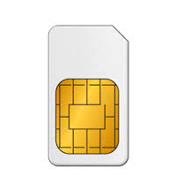


Global Mobile Market Growth
2014
Mobile Operator Revenues
Overview
Overview
3.6bn
4%
CAGR
2020
2014-2020
2014
59%
50%
$1.4tn
2020
CAGR
3.1%
2020
4.6bn
$1.15tn
2014
Penetration Rate
2014
2014-2020
3G/4G Connections
Data Traffic Growth
10 Times(2014-2020)
7.3bn
39%
5.4%
CAGR
2014
3G
4G
2020
69%
2020
5.9
bn
10bn
2.6
bn
SIM Connections
Smart Phone

Slide 44

Global Mobile Economy
Mobile Industry Contribution to GDP
Mobile ecosystem contribution
in the Public Funding
$465bn
US $3.9 tn
4.2% of GDP
2020
2020
$411bn
3.8% of GDP
2014
2014
US $3 tn
Jobs Directly Supported by Mobile Ecosystem
2020
+11.8M
Indirect Jobs
in 2014
15M JOBS
2014
13M JOBS

Slide 45
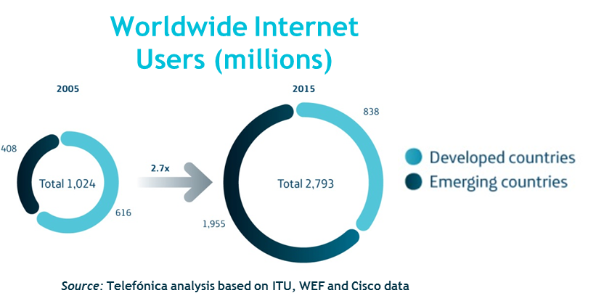
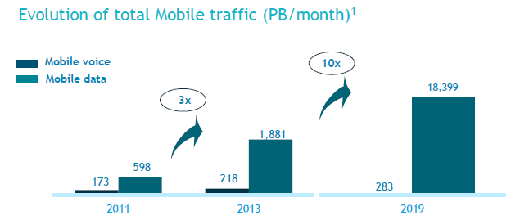
Mobile Traffic Growth
Rise of emerging markets (North vs. South)
A growing data-centric business
2013
2019E
600 MB
2,2 GB
Traffic per customer
Source: CISCO & GSMA Intelligence
Source: Ericsson mobility report Nov.2013
Notes:
4/11/20212011-10-19
45
Challenges: Fundamental difficulties that should be addressed

Slide 46
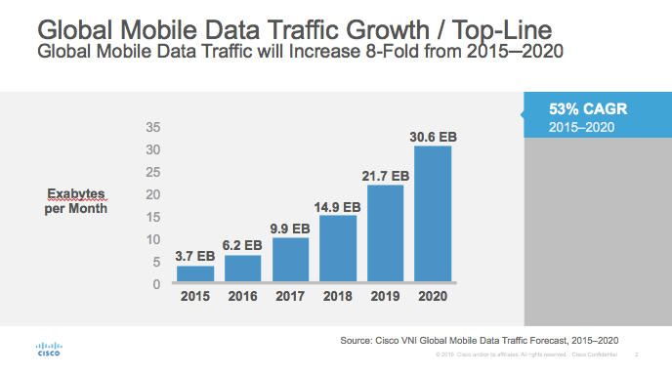
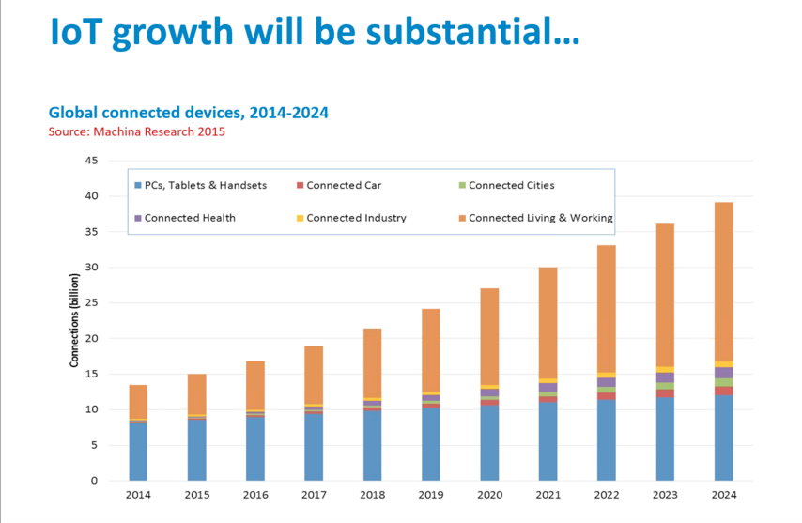
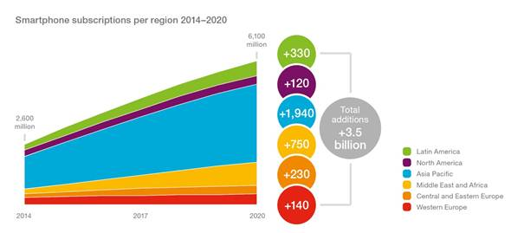
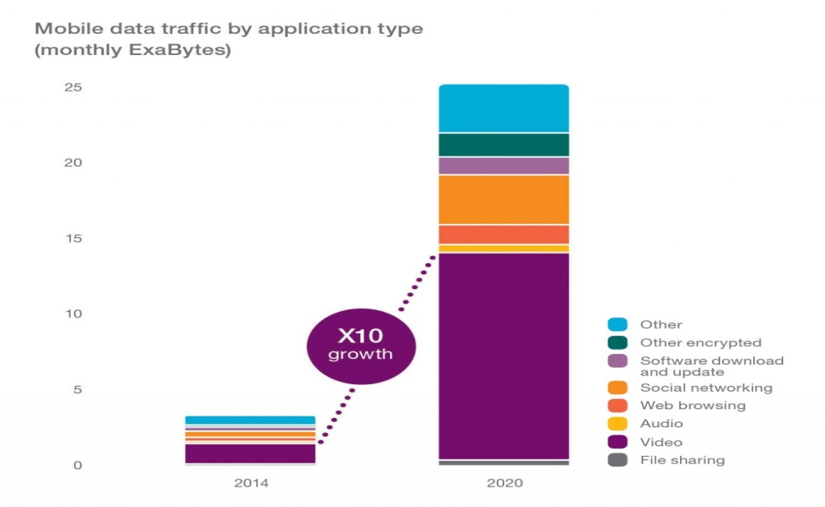
Global Data Traffic Growth

Slide 47
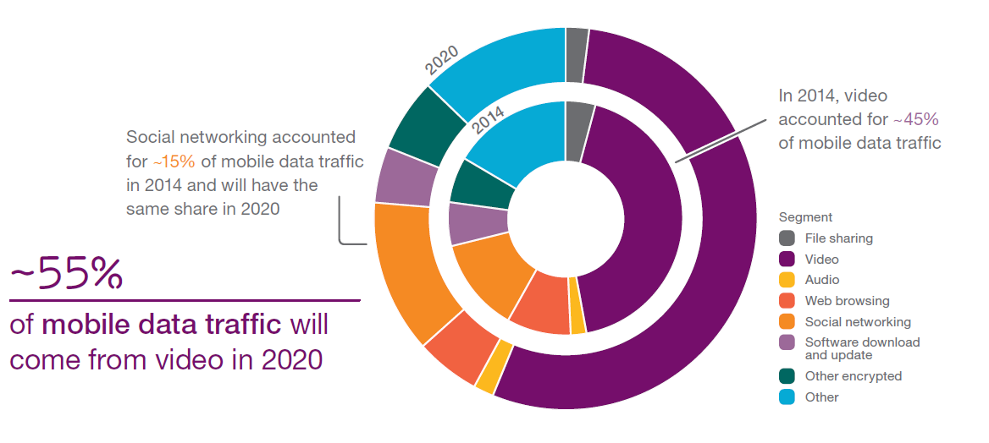
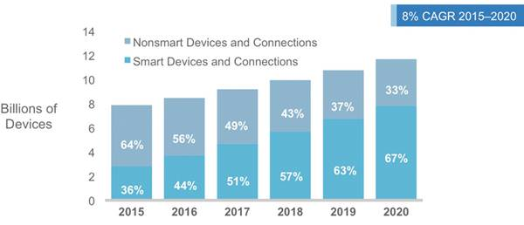
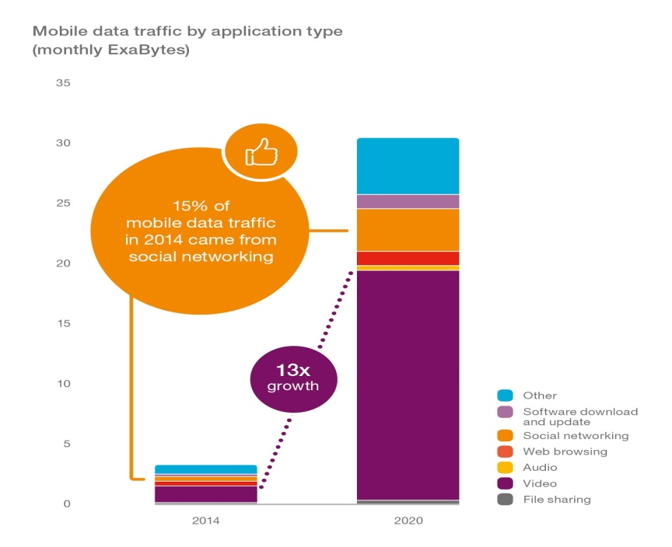
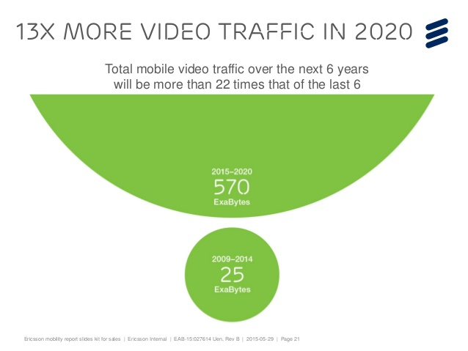
Driving factors for the Data Growth

Slide 48
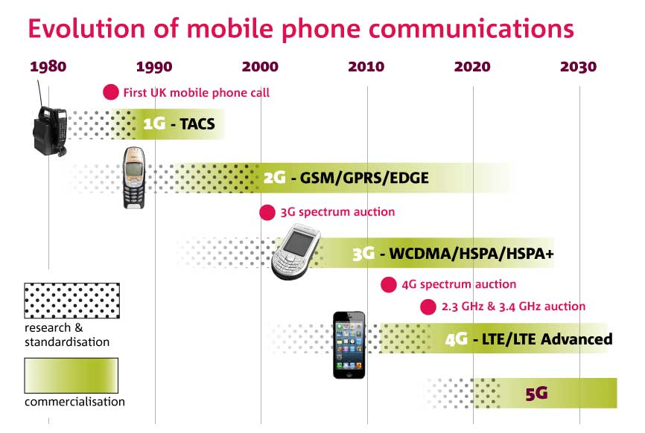
Mobile Networks Evolution- up to 5G
Yesterday
Now
Future
LTE
LTE-A
IMT2020
WCDMA
HSPA
HSPA+
GSM/EDGE
2G
3G
4G
5G

Slide 49
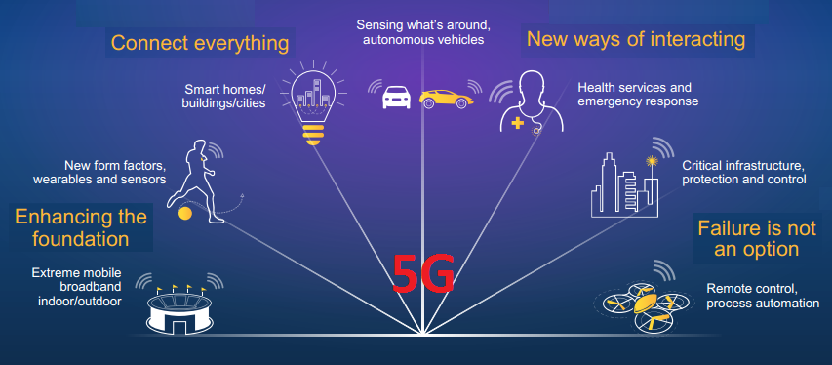

5G is an end-to-end ecosystem to enable a fully mobile and connected society
1000x
10x-100x
5x
Mobile Data Volumes
Connected Devices
Lower Latency
10x-100x
End-user Data Rates
10x
3G
4G
5G
2G
Battery Life for Low Power Devices
Source: METIS

Slide 50
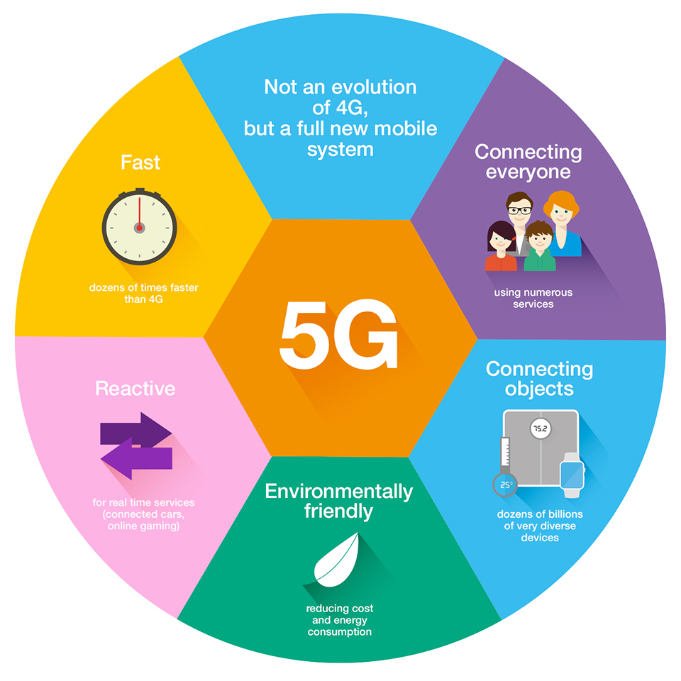
Expectations from 5G Networks
Flexibility
Robustness
Open
Scalable
Mobile
Secure
Programmable
Reliable
Agile
Standardized
Sustainable

Slide 51
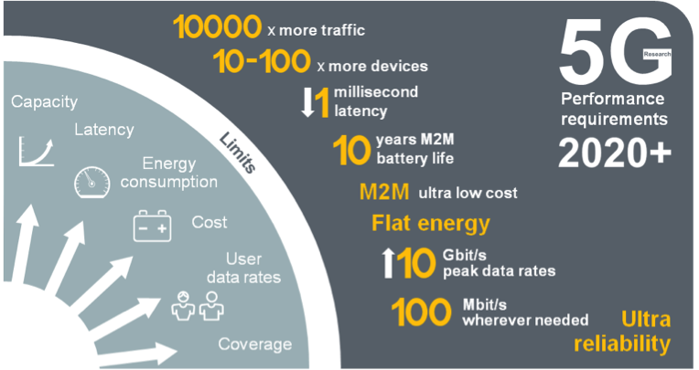
5G Mobile Network Expected Performance
Multi domain performance
Energy Performance
Critical machine type of communications
Global standard

Slide 52
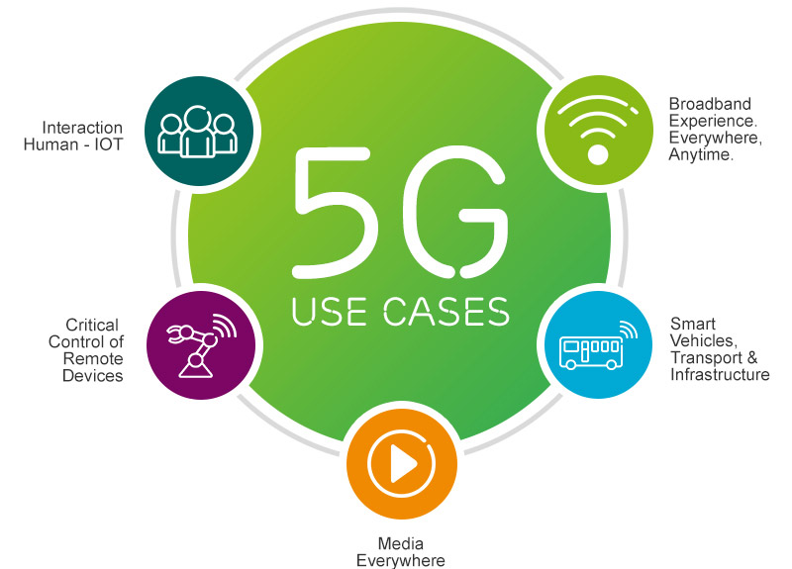

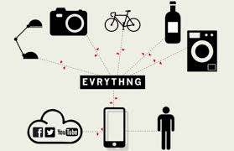

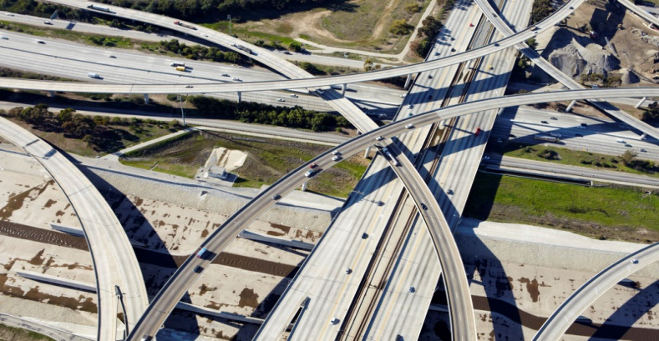

5G Top Use Cases
Broadband experience
everywhere anytime
Massive Machine Type Communication
Critical Machine Type Communication
Mass market personalized TV

Slide 53
Spectrum remains a Challenge for 5G and for Wireless Industry

Slide 54
Three key frequency ranges are currently worthy of consideration for different 5G deployment scenarios
Sub-1 GHz
1-6 GHz
Above 6 GHz
Ideal coverage band could provide a very useful means of extending a superior 5G user experience into rural areas and deep inside buildings.
Could not support extremely wide bandwidths and therefore enable the fastest possible data rates
But Help prevent a new digital divide by ensuring the improved experience.
Reaches more people in both developed, and especially developing, markets.
There are numerous existing mobile bands between 1 GHz-2.6 GHz, and when 5G technology is ready to deploy there may be others between 2.6 GHz and 4 GHz.
Although these bands offer a reasonable mixture of coverage and capacity they are unlikely to be able to support the highest potential 5G data rates without carrier aggregation.
This spectrum could support very wide channel sizes and therefore extremely fast data rates, and massive additional mobile network capacity, making it fertile territory for 5G research.
However, heavy reliance on these bands without complimentary lower frequency spectrum may mean 5G services are limited to small urban areas and inside buildings as its radio propagation qualities would favor small cell sizes.

Slide 55
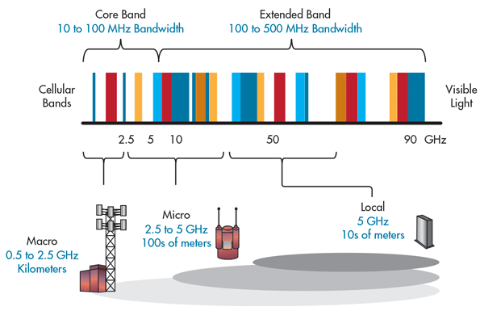
5G Bands and its impact on Cell size

Slide 56




Standardization activity is going on for a global 5G standard
CHINA
NGMN
ITU-R
3GPP
NORTH AMERICA
863, 5G promotion group
EUROPE
JAPAN
Europe
METIS
Horizon2020/5GPPP
ARIB, Testbed activities
4G Americas
University Research
KOREA
5G Forum, Govt push

Slide 57

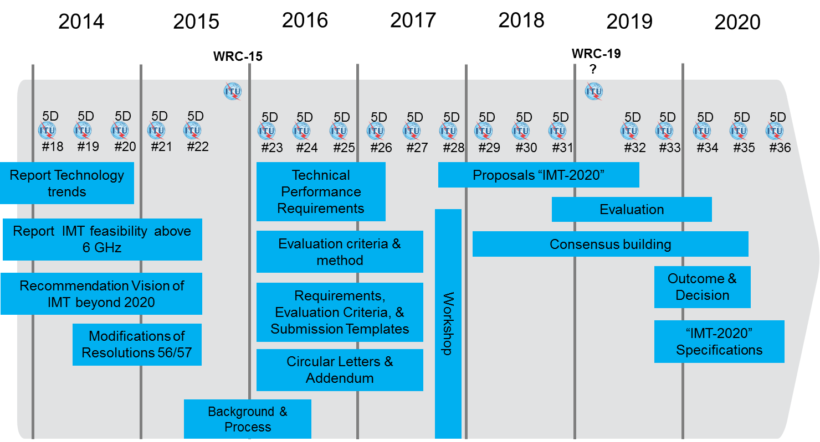
Several Global Initiatives from SDOs, Academia, Industry, and R&Ds working on 5G standardization
Exploratory research
Pre-standardization activities
Standardization activities
Commercialization
2012
2013
2014
2015
2016
2017
2018
2019
2020
WRC’12
WRC’15
WRC’18/19

Slide 58
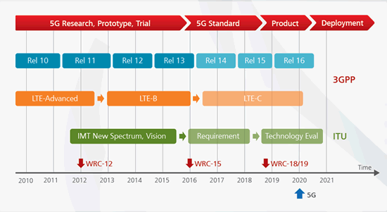
Standardization of 5G Time line (ITU & 3GPP)

Slide 59
Others working Groups Timeline and their Plans
for 5G Standardization Development

Slide 60
Conclusion & Takeaways
5G race is still going on, Commercial deployment of 5G systems is expected in years 2020+, Field trials planned from year 2018 onwards, not yet based on commercial products.
5G will provide at least a ten-fold improvement in user experience compared to 4G in terms of peak data rates and minimal latency
5G will deliver an ecosystem for sustainable technical and business innovation
5G will support multi tenancy and network resource slicing models, New architectures will be used (using Likely many of the generalized concepts –SDR, CR, SDN, NFV, … )
5G will be designed to be a sustainable and scalable technology
5G spectrum and Bands not yet finalized

Slide 61
THANK YOU
Question and Answer

